Slide 1


Santosh Kumar Kar
skkar.2k2@gmail.com

Slide 2

CHAPTER – 9
Zuul
Santosh Kumar Kar,
skkar.2k2@gmail.com

Slide 3
A Context
A system (e.g. Amazon) has fifty micro-services
OrderService
ProductCatalogService
LoginService
OrderHistoryService
PaymentService
And many more
We know each service will be running on different PORT and hence has different URLs
We have to implement an UI, kind of Dashboard which calls multiple servie

Slide 4
Problem with the above design
From a UI developer perspective it has to call fifty REST APIs
each microservice exposes a REST API for communication
Client has to know the details of all REST API and URL patterns/ports to call them
It is kind of a breach of encapsulation; the UI has to know all microservices server/port details to query the services
Think about the common aspects of a web program
CORS, authentication, security, and monitoring in terms of this design
Each microservice team has to develop all these aspects into its own service
Same code has been replicated over fifty microservices

Slide 5
More common problems
Different clients need different data. For example, the desktop browser version of a product details page desktop is typically more elaborate then the mobile version.
Network performance is different for different types of clients. For example, a mobile network is typically much slower and has much higher latency than a non-mobile network. And, of course, any WAN is much slower than a LAN. This means that a native mobile client uses a network that has very difference performance characteristics than a LAN used by a server-side web application. The server-side web application can make multiple requests to backend services without impacting the user experience where as a mobile client can only make a few.
The number of service instances and their locations (host+port) changes dynamically
Partitioning into services can change over time and should be hidden from clients
Services might use a diverse set of protocols, some of which might not be web friendly

Slide 6
Solution
We have only one entry point where all common aspects code is written
The client will communicate to some common URLs similar to common service for all the micro-services
Implement an API gateway that is the single entry point for all clients
The API gateway might also implement security, e.g. verify that the client is authorized to perform the request

Slide 7
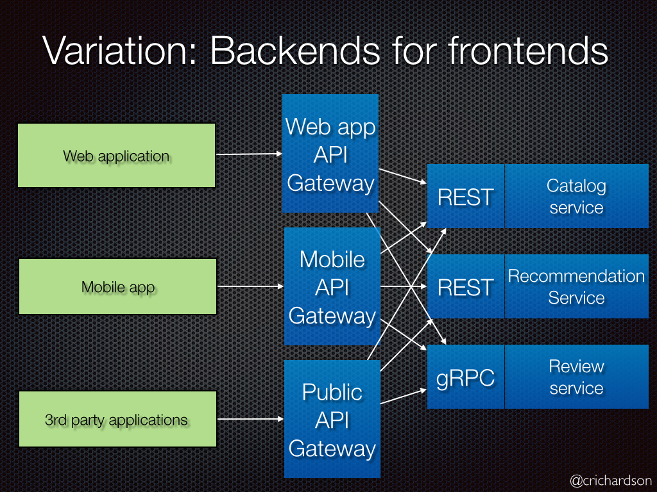

Slide 8
Zuul API Gateway

Slide 9
Zuul API Gateway
Zuul is an edge service that provides
dynamic routing,
monitoring,
resiliency,
security,
and more.
Developed by Netflix

Slide 10
Zuul API Gateway
Zuul uses a range of different types of filters that enables us to quickly and nimbly apply functionality to our edge service. These filters help us perform the following functions:
Authentication and Security - identifying authentication requirements for each resource and rejecting requests that do not satisfy them.
Insights and Monitoring - tracking meaningful data and statistics at the edge in order to give us an accurate view of production.
Dynamic Routing - dynamically routing requests to different backend clusters as needed.
Stress Testing - gradually increasing the traffic to a cluster in order to gauge performance.
Load Shedding - allocating capacity for each type of request and dropping requests that go over the limit.
Static Response handling - building some responses directly at the edge instead of forwarding them to an internal cluster
Multiregion Resiliency - routing requests across AWS regions in order to diversify our ELB usage and move our edge closer to our members

Slide 11
Zuul Components
Zuul has mainly four types of filters that enable us to intercept the traffic in different timeline of the request processing for any particular transaction.
We can add any number of filters for a particular url pattern.
pre filters – are invoked before the request is routed.
post filters – are invoked after the request has been routed.
route filters – are used to route the request.
error filters – are invoked when an error occurs while handling the request.

Slide 12
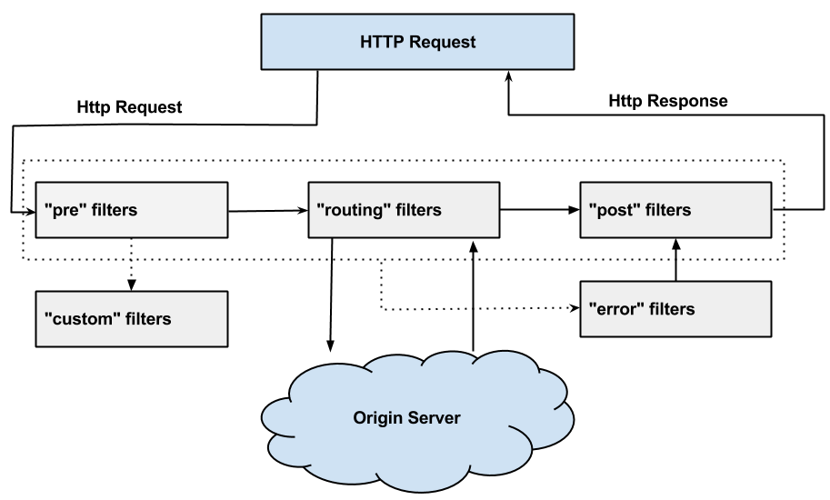
Zuul Request Lifecycle

Slide 13
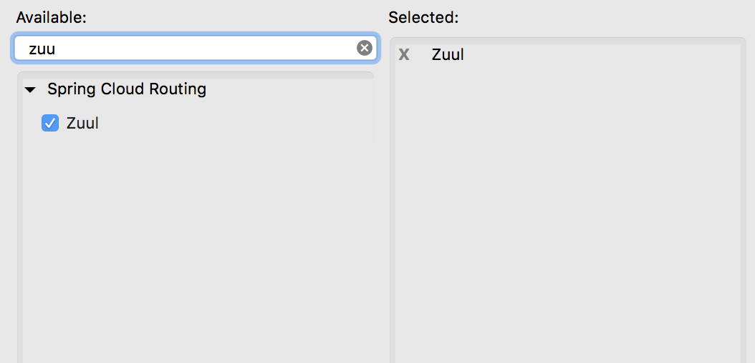
1. Add Zuul Dependency

Slide 14
2. Add routes
Accessing with the micro-service URL
zuul: routes: api-gateway-service: path: /api/service-1/** url: http://localhost:8080/
Accessing with the micro-service Eureka service-id
zuul: routes: api-gateway-service: path: /api/service-1/** service-id: FIRSTEUREKACLIENT

Slide 15
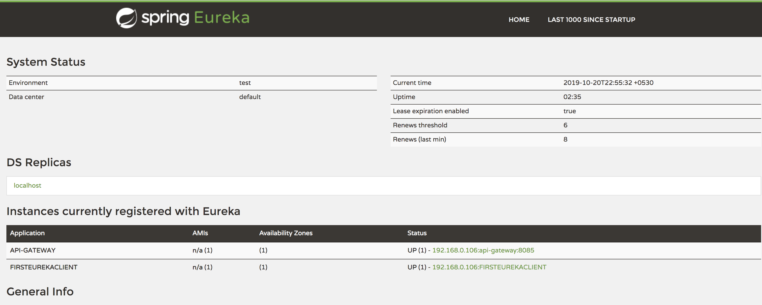

Slide 16
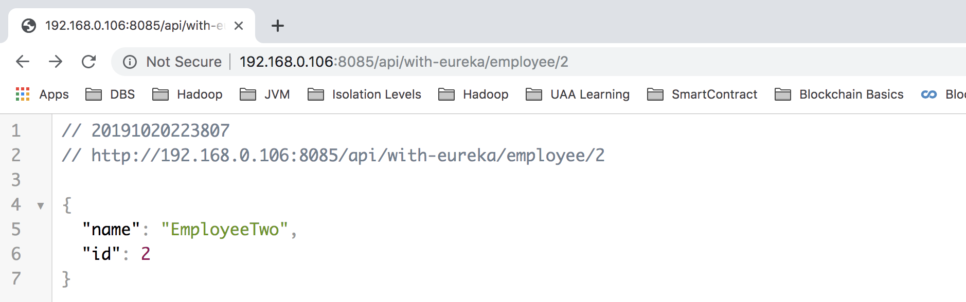
Access with proxy service URL

Slide 17
Adding filters
public class PreFilter extends ZuulFilter { @Override public String filterType() { System.out.println("in pre-filterType()"); return "pre"; } @Override public int filterOrder() { System.out.println("In pre-filterOrder()"); return 1; //Order is applied when the filter type is same } @Override public boolean shouldFilter() { System.out.println("In pre-shouldFilter()"); return true; } @Override public Object run() { System.out.println("In pre-run"); RequestContext ctx = RequestContext.getCurrentContext(); HttpServletRequest request = ctx.getRequest(); System.out.println(String.format("%s request to %s", request.getMethod(), request.getRequestURL().toString())); return null; } }

Slide 18

Questions
Send to skkar.2k2@gmail.com

